Slide 1

SNQF to ACQF
Referencing
7TH ACQF FORUM
NAIROBI 28-30 JULY 2026

Slide 2
Content
Current status of the process
Main conclusions of the 4 criteria
Main issues and challenges in the report
Roadmap to address issues identified

Slide 3

The National Referencing
Team (NRT)

Slide 4

Where are we now?
Action | Status
1. Set up National Referencing Team (NRT)
2. Establish TOR for NRT
3. Collect evidence against the criterion & chapters (consultation, emails, meetings, documents, etc. )
4. Delegate tasks (divide chapter among team members)
5. Set working meeting schedule (to agree on collected info & content of drafts)
6. Compile first draft (then second and so on)

Slide 5

Where are we now?
Action | Status
7. National Validation workshop
8. Consolidated report and final endorsement of participants
9. Present draft to the SQA Board
10. Present current draft to the Executive Committee of the Ministry of EHRD
11. Send latest draft to ACQF Network

Slide 6
Where are we now?
Action | Status
12. Present to ACQF Forum in July
13. Amend final draft to reflect comments received | Pending
14. Present final draft to the Cabinet of Ministers for support | Pending appointment
15. Send final report to ACQF Network | Pending
16. Publish on ACQF designated website and SQA website | Pending
We are here

Slide 7
Criterion 1
There is a clear and demonstrable link between qualification levels in the national qualifications framework or system and the level descriptors of the ACQF.
structural comparison
conceptual and technical comparison

Slide 8
Some similarities and differences in terms of structural comparison.
Dimension | SNQF | ACQF
Structure | 10 levels Levels range from level 1 (Primary Certificate) to 10 (Doctoral Degree) | 10 levels No qualification types attached to the framework. It is a reference framework.
Level Descriptors | Level descriptors for each stage of the framework | Level descriptors for each stage of the framework.
Domains of learning of descriptors | Domains: Knowledge, autonomy and responsibility, skills. Each of the 10 levels is defined by a set of descriptors indicating the learning outcomes in each domain relevant to qualifications at that level. | Domains: Knowledge, skills, autonomy and responsibility Each of the 10 levels is defined by a set of descriptors indicating the learning outcomes relevant to qualifications at that level in any system of qualifications.

Slide 9
Some similarities and differences in terms of structural comparison cont.
Dimension | SNQF | ACQF
Definition of the domains of learning | There is no explicit definition of the domains of learning. | The domains of learning are defined as follows: Knowledge: In the context of ACQF “knowledge” includes various kinds of knowledge such as facts, principles, and theories in various areas Skills: In the context of ACQF “Skills” refer to the ability to use knowledge to respond to information and address problems. Skills include cognitive, communication, digital, green, innovation, practical and social skills. Autonomy and Responsibility: In the context of ACQF “Autonomy and responsibility” refers to the context and extent of the application of autonomy and responsibility
Scope of the three domains of learning | Does not provide details of the scope of the three domains of learning | The scope of the three domains of learning is clarified.

Slide 10
Summary of structural comparison
There is a degree of similarity in terms of the architecture of both frameworks.
Both are 10 level frameworks with identical domains of learning of level descriptors
Both use level descriptors and learning outcomes.
Structurally then, the two bear comparison despite the differences mentioned

Slide 11
Comparison of SNQF to ACQF level descriptors
We also needed to do a conceptual and technical comparison of level descriptors of the 2 frameworks to establish whether there are conceptual links between them.
The use of concepts was examined as well as the outcome statements on both frameworks.
The 2 sets of level descriptors were compared using the descriptors under the ACQF categories of knowledge, skills and autonomy and responsibility

Slide 12
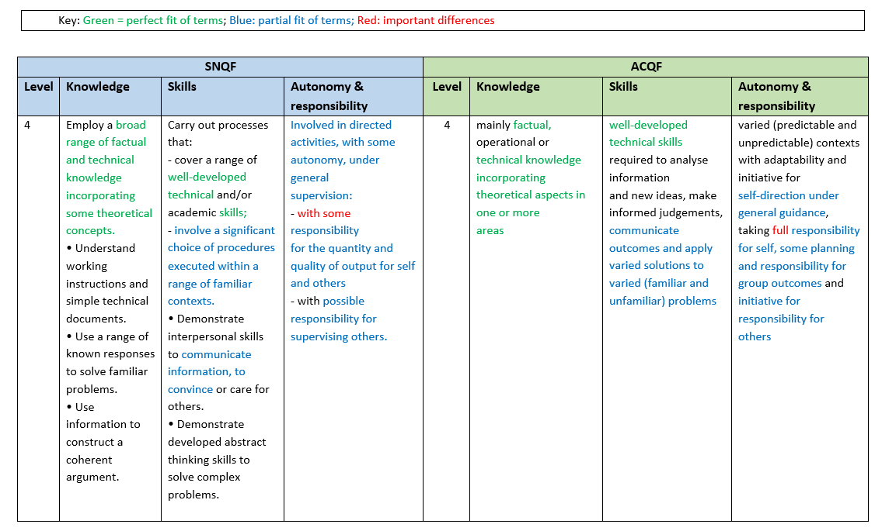

Slide 13
Level 4 Discussion
Knowledge
There is a definite correspondence on the level of knowledge given that both frameworks relate to broad factual and technical knowledge incorporating theoretical aspects or concepts. The difference is that the SNQF goes further with the inclusion of learning outcomes that address understanding of working instructions and simple technical documents, use of responses in the solving of familiar problems and use of information for constructing coherent arguments.

Slide 14
Level 4 Discussion
Skills
There is some alignment in the levels for the two frameworks. Both refer to ‘well-developed technical skills’. There is also similarity in the statements for both levels that address communication of outcomes and information and execution of a range of procedures or solutions within varied contexts and problems. Demonstrating “developed abstract thinking skills to solve complex problems” on the SNQF is broadly consonant with “well-developed technical skills required to analyse information and new ideas, make informed judgements” on the ACQF. The main difference is that in addition to the afore-mentioned, the SNQF contains learning outcomes that relate to values and ethics required in a subject field or discipline.

Slide 15
Level 4 Discussion
Autonomy and responsibility
There is a great degree of alignment between the two sets of level descriptors which is indicated through such phrases as “Involved in directed activities, with some autonomy, under general supervision’ (SNQF), with “adaptability and initiative for self-direction under general guidance” (ACQF) and “responsibility for the quantity and quality of output for self and others - with possible responsibility for supervising others.” (SNQF) with “responsibility for self, some planning and responsibility for group outcomes and initiative for responsibility for others” (ACQF). The main difference is the extent of responsibility with “some responsibility” on the level of the SNQF as opposed to “full responsibility” on that of the ACQF.

Slide 16
Level 4 Discussion
Summary
There is alignment at level 4 of the two frameworks, despite the fact that in each of the three domains there exist one or two differences.

Slide 17
Summary of conceptual & technical comparison
The descriptors target similar cognitive and competency levels, with increasing complexity, autonomy, and responsibility.
The match is more apparent at tertiary level.
The differences have more to do with the fact that ACQF is at meta level (broad for use by multiple countries) while the SNQF is country-specific (more detailed specific, and linked to qualification types, etc.)
The differences between the two sets of level descriptors are not so significant as to prevent referencing.

Slide 18
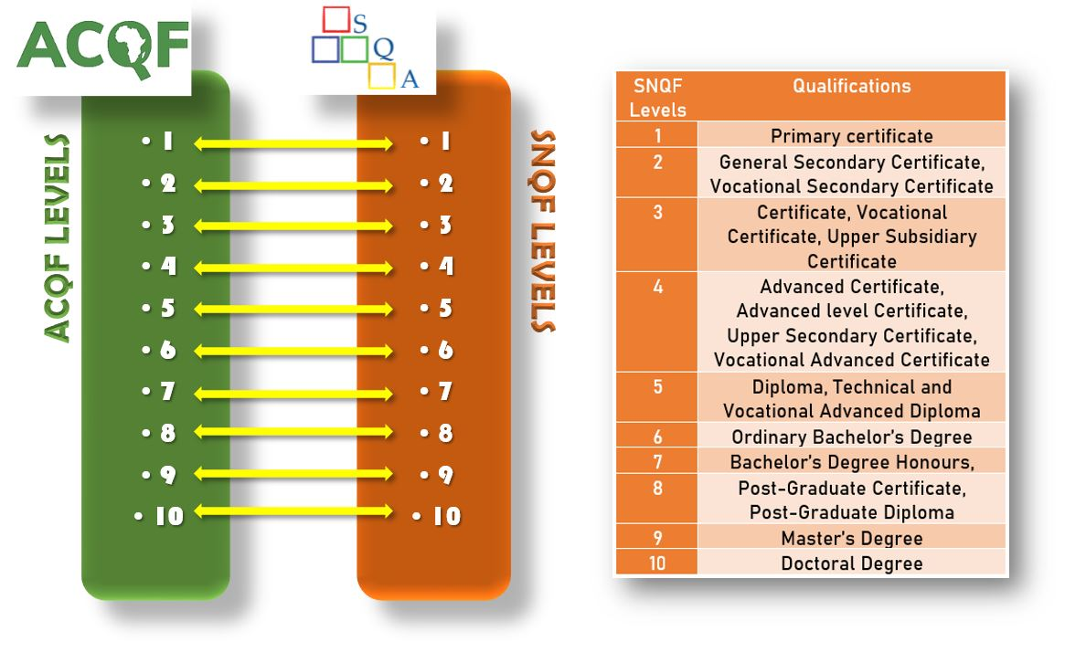
SNQF to ACQF level to level comparison map

Slide 19
Conclusions from Criterion 1
Criterion 1 can be considered met, on the basis of the structural comparison, the side-by-side descriptor analysis, and the level-to-level examination.
The correspondence is not an exact match in every statement or domain at every level, but the evidence demonstrates a sufficiently clear and defensible relationship between SNQF levels and ACQF level descriptors.

Slide 20
Criterion 2
The national qualifications frameworks or systems are based on learning outcomes principles and related to arrangements for recognition of prior learning (including non-formal and informal) and, where appropriate, to credit systems.

Slide 21
Info regarding Learning outcomes (LOs)
LOs in NQF design – SNQF is built on the principle of LOs
Use of LOs across sub-systems:
- in general education (Seychelles National Curriculum Framework);
- in vocational/TVET & tertiary education (in qualification and programme development);
LOs in qualification designs (standards) - an SNQF requirement
LOs as a basis for assessment and certification – part of programme development process
LOs and quality assurance (e.g. in accreditation) – yes, a requirement

Slide 22
Info in relation to RPL and CATS
RPL and CATS are recognised in national legislation: both appear in the NQF Regulations, 2025
- RPL currently undergoing an evaluation/review
The SNQF explicitly includes RPL as a pathway to qualifications ‘there shall be no distinction between a certificate obtained through RPL and that of other modes of learning.’ (NQF Regulations, 2025, 64 (2))
Level of implementation of RPL and CATS across subsystems:
- RPL is established and operational in general education and TVET being piloted for tertiary access with the University of Seychelles
- a national credit accumulation and transfer system has been developed; institutional implementation is in infancy stage

Slide 23
Conclusions from Criterion 2
Criterion 2 is met to a high degree.
The SNQF is clearly based on learning outcomes,
RPL is established and operational
SNCATS has been developed;
Early stage of SNCATS implementation and current piloting stage of RPL for tertiary access are noted. However, these limitations do not negate the criterion, but they do indicate that it will be further strengthened in the very short term.

Slide 24
Criterion 3
There are transparent processes and procedures for including qualifications in the NQF or for describing the place of qualifications in the NQS and information on qualifications is accessible, trustworthy and verifiable in a national register(s) of qualifications.
.

Slide 25
What we needed to document
Legal basis for inclusion of qualifications in the NQF: described in the NQF Regulations, 2025
Embedded in all connected documents (e.g. Manual for development, evaluation and approval of qualifications)
Criteria used for inclusion on NQF:
Learning outcomes: set out in the Manual for development, evaluation and approval of qualifications
Level assignment:‘the decision on the level at which a qualification should be placed in the National Qualifications Framework shall be made based on its match against the level descriptors’ NQF Regulations, 2025 4(5)
QA requirements: set out in the Manual for development, evaluation and approval of qualifications

Slide 26
Processes for inclusion of qualifications
Request for development of qualification is received
Standards Development team is set up
Identification of need based on economic, social & cultural aspects
Analysis of occupational area or profession
Development of qualification by Standards Developers
Verification of 1st draft of qualification by SQA
Evaluation of final draft by Standards Evaluators
Endorsement of qualification by professional council/industry
Approval of qualification by ExCo and registration on NQF

Slide 27
What we needed to document
National register (s) of qualifications
Description of the register (s)
Scope (which qualifications are included): all qualifications registered on SNQF
Structure and data fields: example placed in the annex
Responsible authority: SQA shall ‘maintain a national database of registered and accredited providers, programmes, qualifications and part-qualifications, as prescribed’ SQA Act, 2021 section 4 (2) (c)

Slide 28
What we needed to document
Accessibility and transparency
Is the register:
Publicly accessible (online?) – a .pdf copy is published on the SQA website periodically.
User-friendly – in terms of readability yes, in digital terms, not applicable
Regularly updated –quarterly or as otherwise necessary

Slide 29
Conclusions from Criterion 3
Criterion 3 can be considered met in terms of the existence of policies, procedures, and institutional responsibilities for the registration and placement of qualifications.
However, it is met with implementation limitations in relation to the accessibility, usability and digitisation of the qualifications register. These limitations should be addressed through the operationalisation of SQAIMS and continued strengthening of public access to qualifications information

Slide 30
Criterion 4
The national quality assurance system for education and training refers to the national qualifications framework or system and is consistent with the principles of quality assurance of the African Continental Qualifications Framework (ACQF)

Slide 31
National Quality Assurance System
Functions of SQA in relation to QA: ‘design, develop and implement a common quality assurance system, and regulate compliance therewith’ (SQA Act section 4 (2) (d)
Early childhood under the mandate of IECD
Supporting evidence (SQA Act, Early Childhood Development Act)

Slide 32
Role of various bodies in QA
Assessment bodies: Curriculum, Pedagogy and Assessment Division within the Ministry of EHRD, private schools have internal processes (regulated by Ministry of EHRD and School Inspection Unit of SQA), providers have internal QA processes for assessment, quality assured by SQA’s EQA process)
Certification bodies : public and private education and training providers & ministry responsible for education
Industry bodies: Councils and professional bodies
Funding bodies: the Government for public entities

Slide 33
National Quality Assurance Framework
At the level of SQA
IECD-UNESCO Category 2 Institute
Within tertiary education and training providers
MoEHRD
Councils and professional bodies

Slide 34
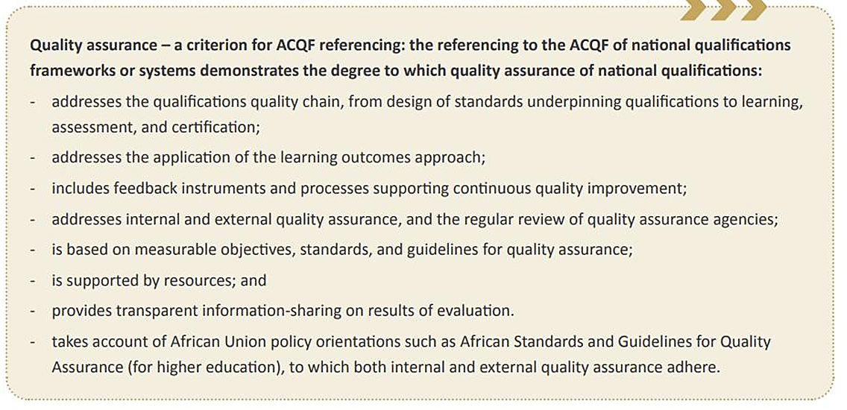

Slide 35
Principles of QA of ACQF | Degree to which the SNQF meets the quality assurance principles of ACQF | Gaps/weaknesses
Addresses the qualifications quality chain, from design of standards underpinning qualifications to learning, assessment, and certification | The QA system of the SNQF addresses the qualifications quality chain, from design of standards underpinning qualifications to learning, assessment, and certification
Addresses the application of the learning outcomes approach | The QA system of the SNQF addresses the application of the learning outcomes approach | No internal institutional manual or guidelines for development and application of learning outcomes at granular level. Tertiary Education and Training Providers use the documents developed by SQA and schools use frameworks developed by the Ministry of Education
Includes feedback instruments and processes supporting continuous quality improvement | The QA system of the SNQF includes feedback instruments and processes supporting continuous quality improvement, such as action plans and progress reports

Slide 36
Principles of QA of ACQF | Degree to which the SNQF meets the quality assurance principles of ACQF | Gaps/weaknesses
Addresses internal and external quality assurance, and the regular review of quality assurance agencies | The QA system of the SNQF addresses internal and external quality assurance through internal institutional audits and self-evaluations, and institutional and programme accreditation. Institutions have clearly stated governance and management structure and QA practices that support the achievement of their mission and legal mandate; published and consistently applied policies and procedures that ensure fair and equitable recruitment and admission, progression, certification and support services for learners and policies and strategies that promote learners’ welfare and guidance; Learners and programme handbooks, assessment policy that is available to learners and staff. Institutions collect, analyse, and use relevant information for the effective management of their programmes of study and other activities; and publish information about their activities, including pro­grammes, through publications and their website. External quality assurance helps institutions ensure the effectiveness of their internal QA mechanisms, and provides an instrument for assessing institutional quality; standards, criteria and processes for external quality assurance are designed to be fit for purpose; standards, processes, and procedures for EQA are pre-defined, reliable, published, and consistently implemented for purposes of accountability; EQA is carried out by panels of external experts; reports and outcomes of external quality assurance are clear, based on published standards, processes and procedures, and made acces­sible, for purposes of improvement and accountability; EQA of institutions and programmes is undertaken on a cyclical basis; the procedure for lodging complaints and appeals is clearly defined; | Issue of regular review of quality assurance agencies since SQA is the sole quality assurance agency in the country. Internal self-assessment of its processes, practices and activities is carried out but this is not adequately structured and documented. Not yet subjected itself to periodic external review by regional, continental or international QA bodies.

Slide 37
Principles of QA of ACQF | Degree to which the SNQF meets the quality assurance principles of ACQF | Gaps/weaknesses
Is based on measurable objectives, standards, and guidelines for quality assurance | The QA system of the SNQF is based on measurable objectives, standards, and guidelines for quality assurance The Early Childhood Development Act and Framework, 2022 makes provision for quality assurance of this sector.
Is supported by resources | The QA system of the SNQF is supported by resources from the Government budget
Provides transparent information-sharing on results of evaluation | Provides transparent information-sharing on results of evaluation in that institutional accreditation and School Inspection reports are circulated to stakeholders and result sheets for programme accreditation are circulated to institutions, the National Qualifications Framework Regulations, 2025 makes provision for results of evaluation to be gazetted and publicised.

Slide 38
Principles of QA of ACQF | Degree to which the SNQF meets the quality assurance principles of ACQF | Gaps/weaknesses
Takes account of African Union policy orientations such as African Standards and Guidelines for Quality Assurance (for higher education), to which both internal and external quality assurance adhere | The national QA systems take account of the African Standards and Guidelines for Quality Assurance (for higher education), to which both internal and external quality assurance adhere on most standards | Periodic internal and external reviews of the national QA agency (SQA) for continuous improvement is not being done. Internal review is done to some extent but it is unstructured and ad-hoc. The system for continuous QA of its own practices is fragmented with the main focus being on what has been achieved. There is need to consider planned and periodic comprehensive internal self-assessment of its processes, practices and activities, including data analysis. There is a need for SQA to subject itself to periodic external review on the basis of self-assessment by a regional, continental or international QA body. The challenge has been to secure the financial resources for such project as SQA is a Government budget-dependent body and other priorities take precedence. Process initiated with INQAAHE (International Network for Quality Assurance Agencies in Higher Education) in November 2024.

Slide 39
Quality assurance of the SNQF and register of qualifications
Quality assurance of the SNQF is maintained through the NQF policies, guidelines and procedures that are developed, implemented and periodically revised.
Maintains a register of qualifications and part-qualifications; updated periodically, and reports are uploaded on the SQA website for public information.

Slide 40
Transparency and dissemination of quality assurance regulations
The SQA’s Customer Service Charter (2022)
Appeal: The SQA Act 2021 and NQF Regulations, 2025
Publication of SQA annual reports, annual newsletters
Publication on SQA website of accreditation status of programmes and institutions; the list of registered qualifications and part-qualifications.
The SQA legal instruments, policies, guidelines, manuals and procedures on SQA website or on demand

Slide 41
Data, analysis on quality and effectiveness of qualifications for users, labour market and society.
An area not yet considered.

Slide 42
Conclusions from Criterion 4
Criterion 4 is met to a significant extent, as the national quality assurance system clearly refers to the SNQF and incorporates many of the quality assurance principles relevant to ACQF referencing.
However, the criterion is not yet fully mature in implementation, particularly with regard to systematic internal review, periodic external review of SQA, and the collection and analysis of evidence on qualification effectiveness.

Slide 43
Governance & follow-up
Responsibilities and/or legal competence of relevant national bodies involved in the ACQF referencing process. | SQA, a regulatory body operating under an Act, as the relevant national body that led the ACQF referencing process. A National Referencing Team Consultations and presentations with stakeholders
Involvement of people from other countries who are experienced in the field of qualifications | Representatives of countries participating in the ACQF project involved in certain aspects and steps of the referencing process in an advisory and supportive role and as critical friends through peer reviews. The ACQF Governance Structure provides the platform by enabling countries to present progress in Forums organised and gain input. Involvement of two international experts.
The referencing outcome is published by the participating country and the ACQF network | The referencing report once validated by the ACQF Governance Structure will be: circulated to stakeholders published on the SQA website published on the ACQF dedicated website

Slide 44
Governance & follow-up cont.
All newly issued documents related to qualifications that are part of the national qualifications framework (e.g.: certificates, diplomas, transcripts) and qualifications registers will contain a clear reference to the appropriate ACQF level, based on national legislation and procedures. | Qualifications uploaded in our qualifications register will contain a field for ACQF levels. The National Qualifications Framework Regulations, 2025 makes provision for issued documents related to qualifications that are part of the SNQF to be endorsed by and include such information as may be determined by the competent national authority (SQA). Regulation 67. (3): ‘Certificates issued for qualifications in the National Qualifications Framework shall be endorsed in the manner determined by the Authority.’ Regulation 68. (2) (e): ‘the design of the transcript shall be the responsibility of the provider but the content shall include […] such other information as may be determined by the Authority.’

Slide 45
Issues to be addressed
Absence of a Centralised Information Management System
Weak internal quality assurance mechanisms
Need for external review
Inadequate stakeholder involvement in qualification design
Definition of the three domains of learning of the SNQF
Clarifying the scope of the domains of learning
Lack of systematic data on qualification effectiveness

Slide 46
Roadmap for addressing the issues
Phase | Issue / Action Area | Objective | Timeline | Priority | Existing Status | Dependencies
Phase 1: Immediate Foundations (1st - 4th quarter 2027) | Define SNQF Domains & Scope | Define and clarify the three domains of learning and competency expectations. | 1st quarter 2027 | High | Low | Must precede external review
 | Develop Internal Quality Assurance (QA) Framework | Develop an internal Quality Assurance Policy and Framework | 2nd to 4th quarter 2027 | High | Medium | Availability of financial resources for consultancy
 | Improve Stakeholder participation in qualification design | Develop a plan for systematic and structured stakeholder engagement and implement. | 2nd to 4th quarter 2027 and ongoing for implementation | High | Medium | Supports QA framework Strong, formalised partnership with Ministries required to create Councils

Slide 47
Roadmap for addressing the issues
Phase | Issue / Action Area | Objective | Timeline | Priority | Existing Status | Dependencies
Phase 2: Systems Development (2nd quarter 2026-2nd quarter 2027) | Develop Centralised Information Management System | Design a Centralised Information Management System and implement | 2nd quarter 2026 to 2nd quarter 2027 and ongoing for implementation | High | Low | Requires internal stakeholder input

Slide 48
Roadmap for addressing the issues
Phase | Issue / Action Area | Objective | Timeline | Priority | Existing Status | Dependencies
Phase 3: External Review & Improvement (2nd quarter 2028 and ongoing) | Undergo External Review | Engage regional/continental QA bodies for external review | 2nd quarter 2028 | High | Low | Dependent on QA framework and financial resources for consultancy
 | Improve continuously from external review findings | Use external review findings to refine QA framework and establish periodic review cycles. | 1st quarter 2029 and ongoing | High | Medium | Dependent on external review

Slide 49
Roadmap for addressing the issues
Phase | Issue / Action Area | Objective | Timeline | Priority | Existing Status | Dependencies
Phase 4: Data collection & analysis (from 1st quarter 2028) | Collect & Analyse data on impact of qualifications | Establish mechanisms for collecting and analysing data on the quality and impact of qualifications for learners, employers, and society | From 1st quarter 2028 | High | Low | Technical and financial resources
Monitoring & Evaluation Framework Quarterly progress reviews by SQA leadership. Annual stakeholder reports for transparency. Mid-term evaluation (18 months) to adjust timelines/resources. Final evaluation (36 months) to assess impact and readiness for next cycle.

Slide 50
Asante!
Thank you!
Merci!
Obrigada!

